Slide 1
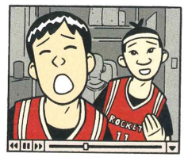
Week 4 Bring your book to section this week!
Today:
Foundation:
What this text is “about,” its message for middle schoolers and how conveyed by visuals
Complications: debate or critique above middle school messages
I. Performance and transformation
Wed: II. Consequences of animal substitution?

Slide 2
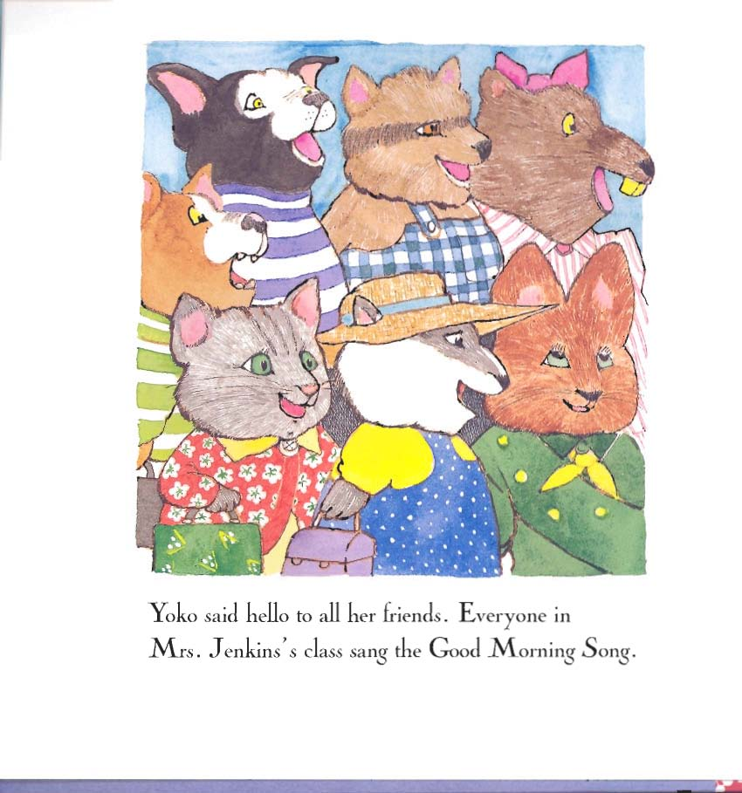
animal multiculturalism? species diversity?

Slide 3
Is race in this picture? Miss Bindergarten’s Kindergarten series, Slate and Wolff, 1996

Slide 4
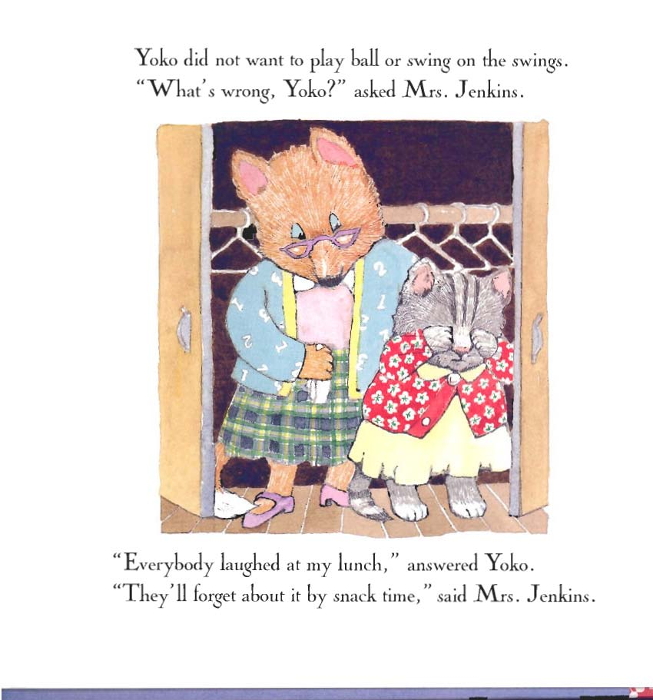
racial trauma by proxy?
“We expect a white child to find it easy to identify with an animal but not with a black character. Is the child further removed from a person of another race than another species?
That’s ludicrous.”
Kathleen Horning, Director,
Cooperative Children’s Book Center, UW 2016

Slide 5
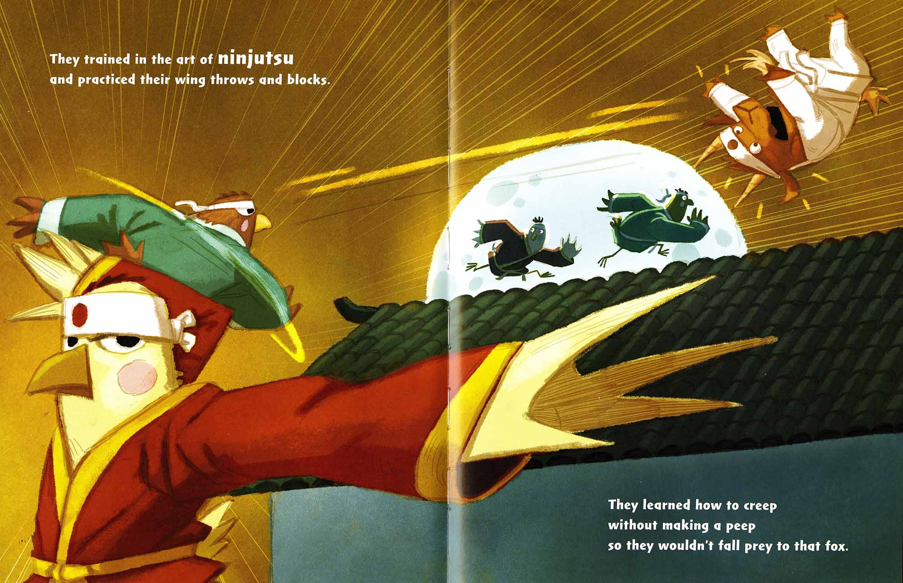
Do animal proxies “count” as ”Asian,” as multicultural content? Hensel and Gretel: Ninja Chicks, 2016 Corey Rosen Schwartz, Rebecca Gomez, Dan Santat (Yes and no: This book counts because illustrator Dan Santat is Thai American)

Slide 6
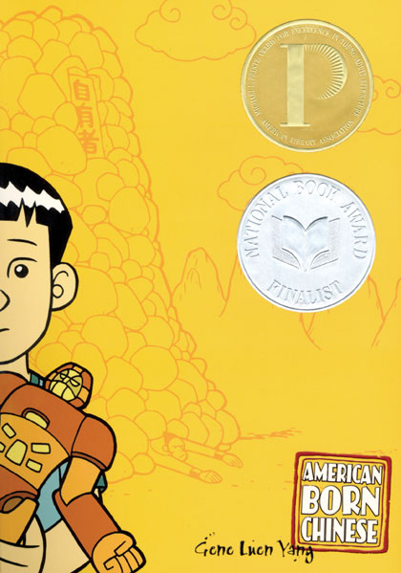
Reason for ABC’s awards: graphic novel form message to young people --Foundation: how the novel develops its message close reading –interpretation as method

Slide 7
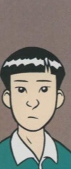
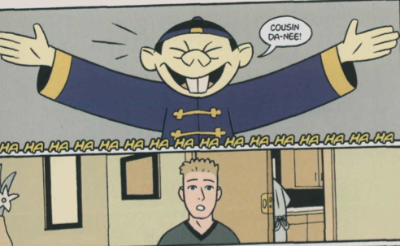
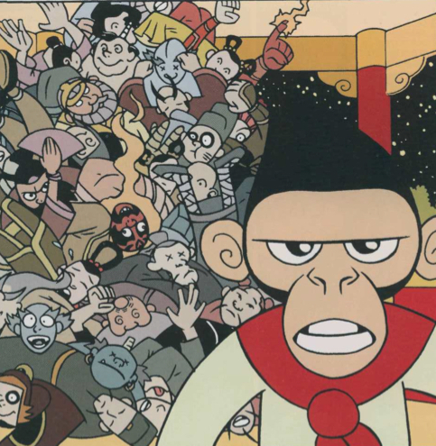
3 converging narratives: the Monkey King, Jin, and “Danny”

Slide 8
Internalized racial trauma: “hallucinatory whiteness”
“Is it so bad to grow up Asian in America? One might be forgiven for asking upon encountering American Born Chinese . . . . After all, Asians are widely perceived to have it easier than other minorities in the United States. . . .Yang makes growing up Chinese in California seem positively terrifying.”
New York Times Book Review, 2006, emphasis mine

Slide 9
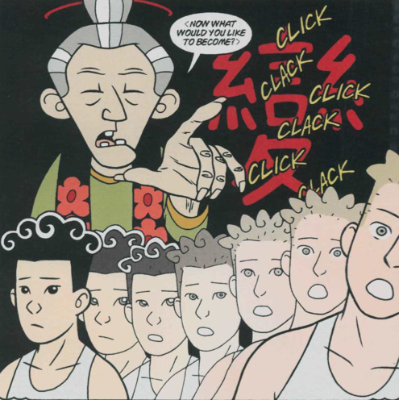
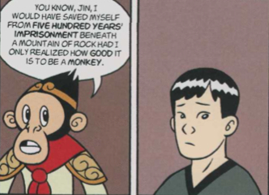
ABC’s conflict:
. . . and resolution:

Slide 10
How does this cover illustration give clues as to the themes of this work?
What stands out to you about the design, graphics, color, wording or other choices made here?

Slide 11
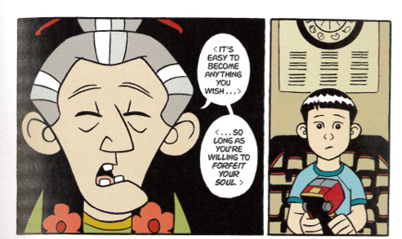
transformation as duplicity:

Slide 12
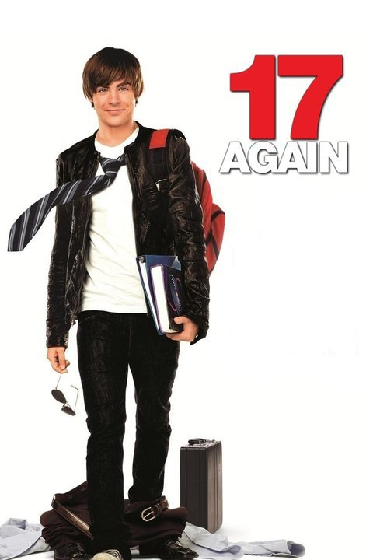
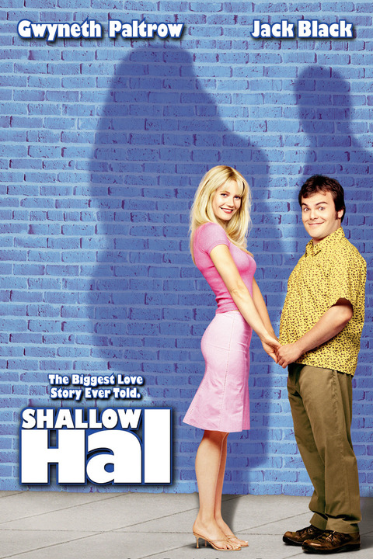
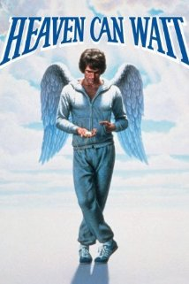
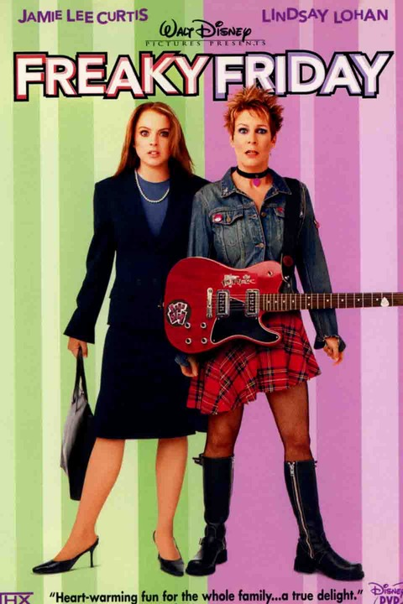
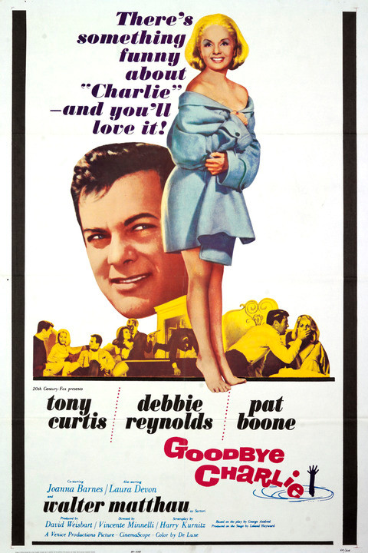
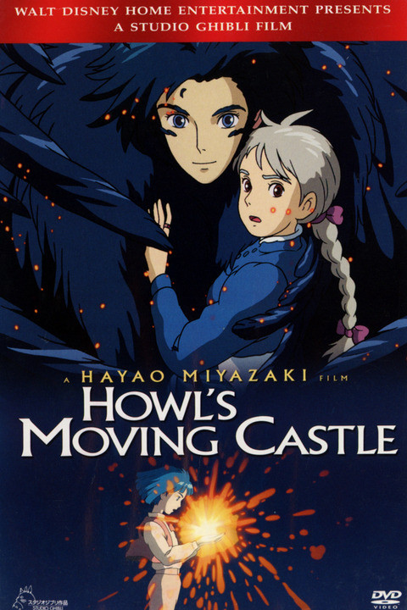
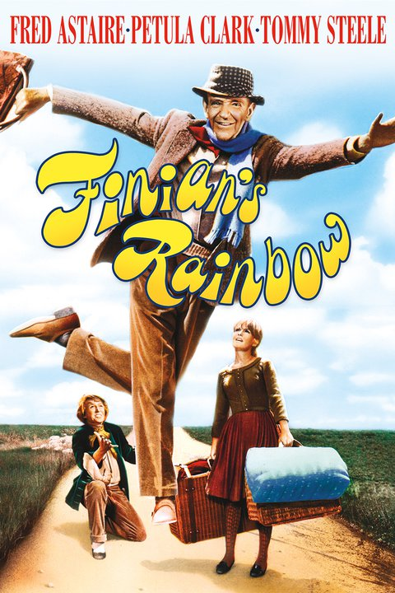
body swap films

Slide 13
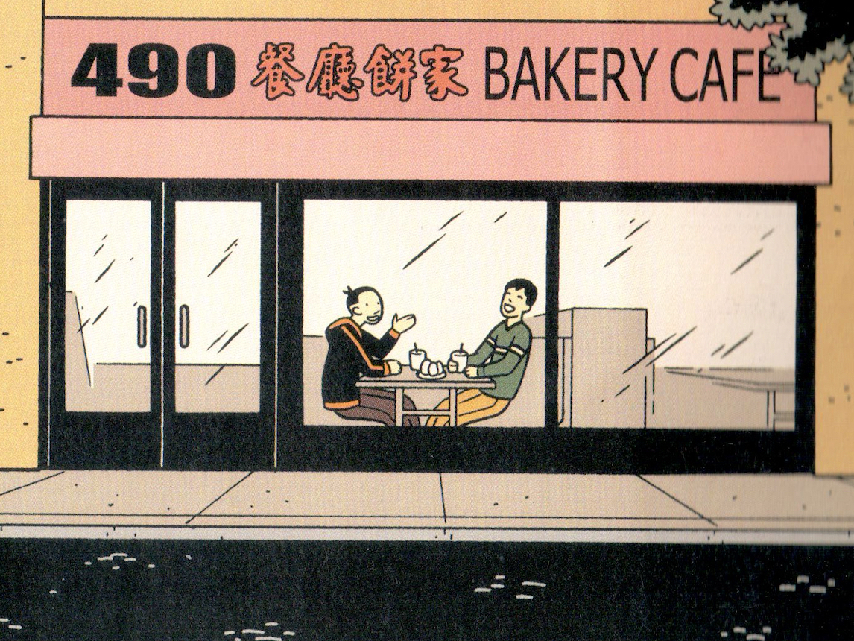

Slide 14
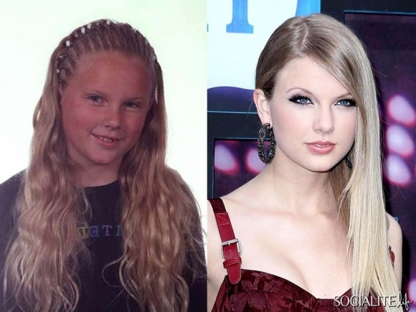
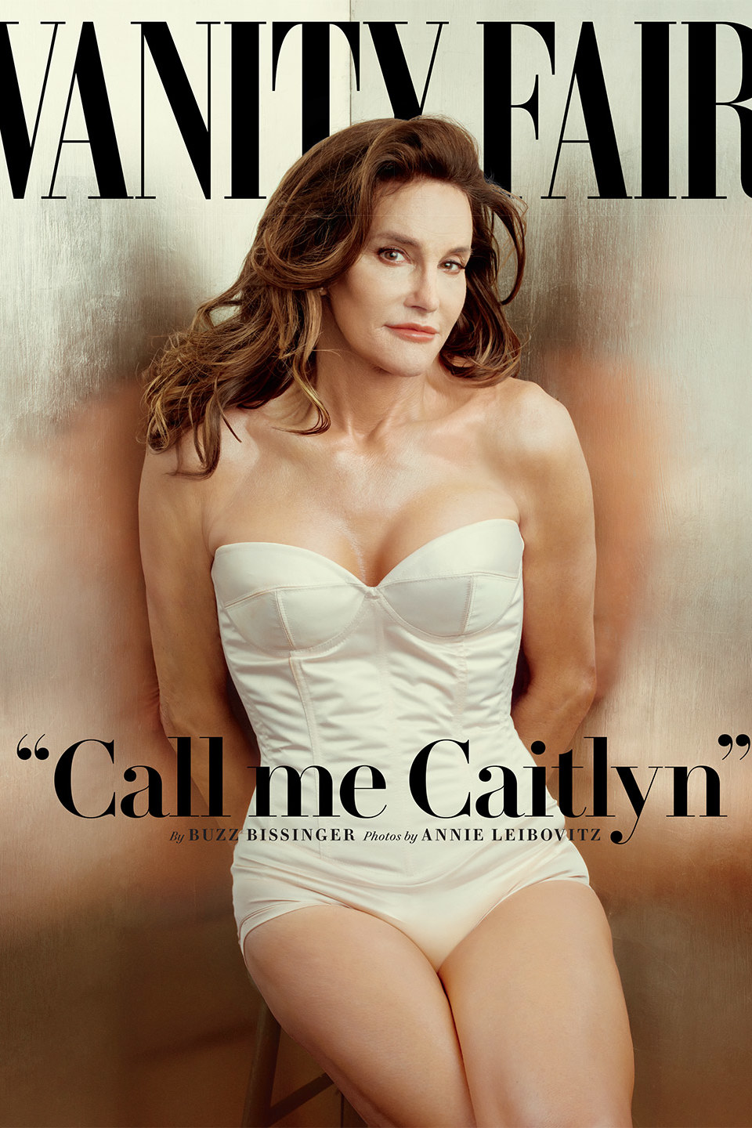
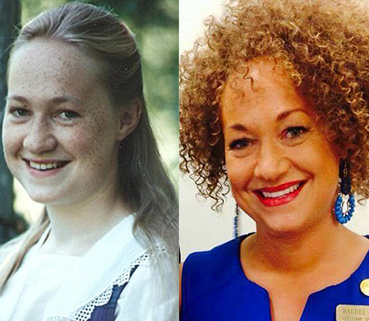
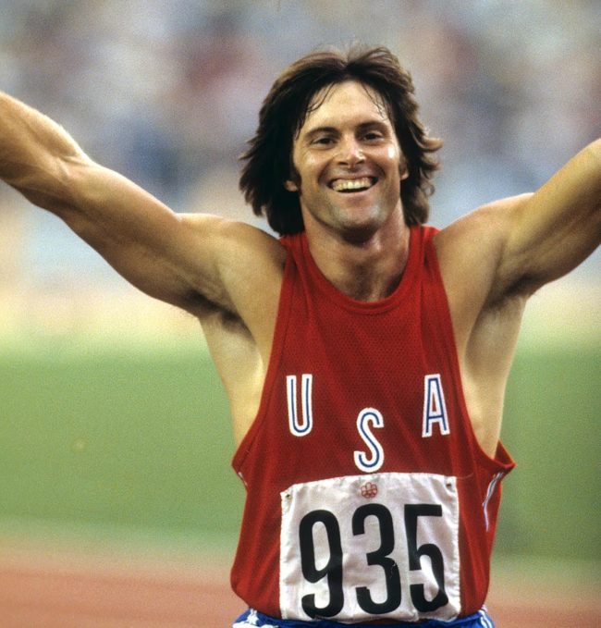
“Change!”

Slide 15
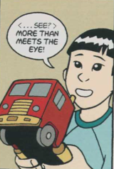
ABC’s resolution is invested in the restoration of “true forms,” but is this what the text shows?

Slide 16
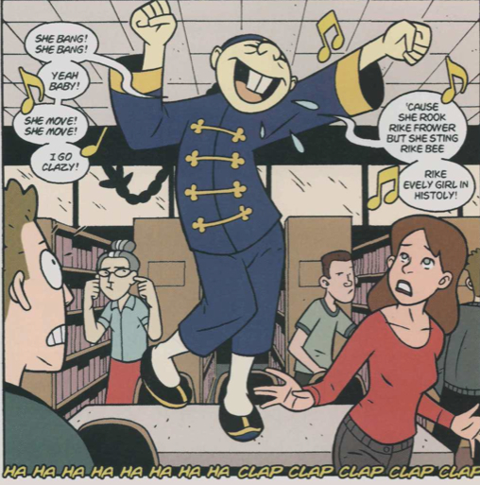
degrees of authenticity?
Monkey King as Chin-Kee as William Hung as Ricky Martin aka Enrique Martín Morales
Jin and Wei-Chin as Youtube’s “Two Chinese Boys” as the Backstreet Boys as the Houston Rockets

Slide 17
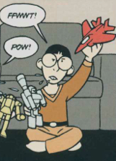
Reading Images with and against the text Does American Born Chinese validate the notion of one’s “true form”? Or do multiple impersonations, shape-shifting, and imposture counter notions of the authentic, a ”true form”? What might be the significance of layering so many examples of imposture within one text?
I am not the real Gene Yang

Slide 18
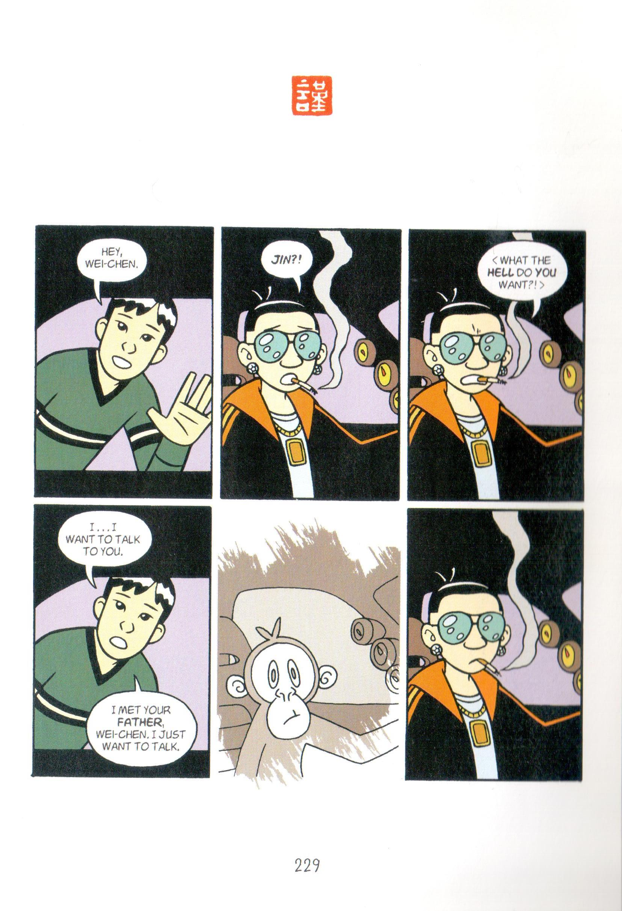

Slide 19
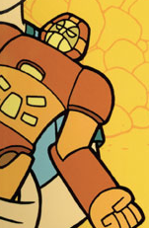
How can ABC help us unpack the association between who we are and how we appear to others?
What is “us” and what is a (expected, coerced, conditioned) performance of an identity?

